Slide 1
Packages
Chapter 2

Slide 2
1. Package Fundamentals
What is a package
A java package is a collection of
classes, interfaces, sub-packages, exceptions, enums, etc.
Why to use packages (Advantages)
avoid name collision.
Encapsulate more than one class.
Helps categorize the classes and interfaces.
Easy to maintain.

Slide 3
1. Package Types
Package types
Built-in package
User-defined package

Slide 4
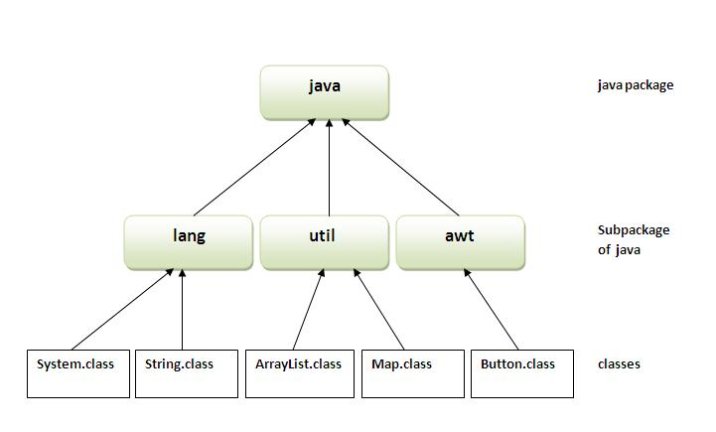
1. Built-in package

Slide 5
2. User-defined package
2.1. Creating a package:
2.2. Compiling a package:
2.3. importing a package:

Slide 6
2. User-defined package
2.1. Creating a package
2.2. Compiling a package
2.3. importing a package
Syntax
package mypackage;
public class someClass {
// code
}

Slide 7
2. User-defined package
2.1. Creating a package
2.2. Compiling a package
2.3. importing a package
SomeClass.java
After compilation,
A new directory created with name mypackage under specified path.
“.class” file generated will be added under directory mypackage.
package mypackage;
public class someClass {
// code
}
d:\javaTest>
javac -d path SomeClass.java

Slide 8
2. User-defined package
Example
myComputer
C :
D :
Rectangle.java
javaList
JavaTest
package mypackage;
public class Rectangle {
// code
}
Rectangle.java
mypackage
Rectangle.class
d:\javaTest>
javac -d D:\javaList Rectangle.java

Slide 9
2. User-defined package
Example
2.2. Compiling a package
myComputer
C :
D :
someClass.java
javaList
JavaTest
package mypackage;
public class someClass {
// code
}
SomeClass.java
mypackage
SomeClass.class
d:\javaTest>
javac -d . someClass.java

Slide 10
2. User-defined package
2.3. importing a package:
import mypackage.className ;
public class DemoClass {
// main method that use package classes
}

Slide 11
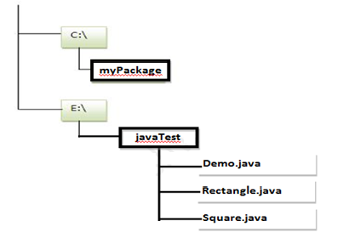
2. EXAMPLE: Lab Program
Complete the following:
Create a package named shape.
Create some classes in the package shape like
Square, Triangle, and Circle.
Import and compile these classes in Demo class program..
d:\
Package created After compilation
shape
Square.java
Working directory
Triangle.java
Rectangle.class
Circle.java
Square.class
Demo.java
Circle.class

Slide 12
2. EXAMPLE: Lab Program
Triangle.java
d:\
package shape;
public class Triangle {
private double breadth, height;
public void setTriangle ( double breadth, double height ) {
this.breadth = breadth;
this.height = height;
}
public void getArea(){
double area = 0.5 * breadth * height;
System.out.println (“Area of Triangle =” + area);
}
}
Triangle.java

Slide 13
2. EXAMPLE: Lab Program
Square.java
d:\
package shape;
public class Square {
private double side;
public void setSquare ( double side ) {
this.side = side;
}
public void getArea(){
double area = side * side;
System.out.println (“Area of Square =” + area);
}
}
Triangle.java
Square.java

Slide 14
2. EXAMPLE: Lab Program
Circle.java
d:\
package shape;
public class Circle {
private double radius;
public void setSquare ( double radius ) {
this.radius = radius;
}
public void getArea(){
double area = (0.5) * (3.14) * radius * radius;
System.out.println (“Area of Circle =” + area);
}
}
Triangle.java
Square.java
Circle.java

Slide 15
2. EXAMPLE: Lab Program
D:\javaTest>
Javac -d • Triangle.java
D:\javaTest>
Javac -d • Square.java
D:\javaTest>
Javac -d • Circle.java
d:\
Package created After compilation
shape
Triangle.java
Working directory
Square.java
Triangle.class
Circle.java
Square.class
Circle.class

Slide 16
Importing shape in Demo program
Demo.java
d:\
Import shape.Triangle;
Import shape.Triangle;
Import shape.Triangle;
public class Demo {
public static void main (String [] args) {
Triangle t = new Triangle();
t.setTriangle (5.6, 6.4);
t.getArea();
Square sq = new Square();
sq.setSquare (10.5);
sq.getArea();
Circle round = new Circle();
round.setCircle (5.6);
round.getArea();
}
}
Triangle.java
Square.java
Circle.java
Demo.java

Slide 17
1. Controlling access to class members
class ClassName {
Access _specifiers Variables;
Access _specifiers methods;
}
Modifier
Private
Default
Protected
public
With members

Slide 18

1. Controlling access to class members
Same package
Other package
Modifier
Private
Default
Protected
public
Same class | Other class | Sub class
Sub class | Other class

Slide 19
Example: Controlling access to class members
Class Person {
private int num1;
public int num2;
int num3;
void setVal ( ) {
num1 = 10; num2 = 20; num3 = 30;
}
}
class OtherClass {
public static void main (String [ ] args)
{
Person ob = new Person() ; ob.num1 = 10;
ob.num2 = 20;
ob.num3 = 40;
}
}
Default variable
Default method
Can access all variables
Error
okay
Notes:
A message - is used to communicate between processes.
A packet - is a fragment of a message that might travel on a wire.

Slide 20
Example: Controlling access to class members
Class Person {
private void show ( ) {
System.out.println(“Private Method”) ;
}
public void display ( ) {
System.out.println(“Public Method”) ;
}
}
class OtherClass {
public static void main (String [ ] args) {
Person ob = new Person() ; ob.show( );
ob.display( );
}
}
Error
Notes:
A message - is used to communicate between processes.
A packet - is a fragment of a message that might travel on a wire.

Slide 21
Example: Controlling access to class members
Class Person {
private void show ( ) {
System.out.println(“Private Method”) ;
}
public void display ( ) {
System.out.println(“Public Method”) ;
show();
}
}
class OtherClass {
public static void main (String [ ] args) {
Person ob = new Person() ; ob.display( );
}
}
Notes:
A message - is used to communicate between processes.
A packet - is a fragment of a message that might travel on a wire.

